Slide 1



Quantifying Classification Uncertainty using Regularized Evidential Neural Networks
Xujiang Zhao¹, Yuzhe Ou¹, Lance Kaplan², Feng Chen¹, Jin-Hee Cho³
¹The University of Texas at Dallas, ²US Army Research Lab, ³Virginia Tech
Archive version available at: https://arxiv.org/pdf/1910.06864

Slide 2
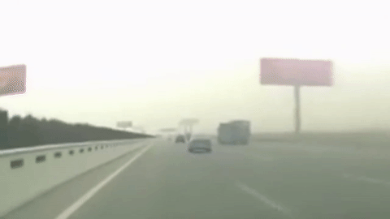
Why is predicting uncertainty important?
Notes:
Imagine that an autonomous vehicle is driving on a road. We see it is a foggy day so we don’t have good visibility today. If this vehicle make an incorrect prediction, it is highly risky as it may have an accident.

Slide 3

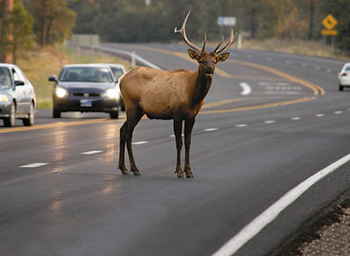
Uncertainty vs. Misclassification
Is it important to know:
why we don’t know?
how much we don’t know?
So how can we predict the uncertainty based on its root cause?
Would it really help for our decision making?
What do you prefer for your decision making?
Wrong information? (misclassification)
vs.
Knowing uncertainty and where is it from?
When our model only knows `car’ and `road,’
Incorrect prediction
1
High Uncertainty
Misclassify “car” as “road”
2
Out-of-distribution
？
High Uncertainty
Misclassify “deer” (OOD object) as “car”
Notes:
High uncertainty may make a decision delayed but can avoid risk or negative outcome. However, misclassification leads to an incorrect decision and may introduce a more serious risk.
Misclassify a known object with another known object to the model: misclassify car as road. This misclassification may lead to a more serious risk because the autonomous car will proceed as if there is nothing in front.
Misclassify an unknown object with another known object to the model: misclassify deer as car. We call this out-of-distribution.
Can we make our model know the level of uncertainty in detecting a given object, instead of letting it generate misclassification?
We need to shift our paradigm from `I know all’ to `I don’t know all’. Why is this paradigm shift useful? I will look into more to answer this question.

Slide 4
What types of uncertainty to model?
1
Epistemic uncertainty (a.k.a. model/parameter uncertainty)
Measures what model doesn’t know
Due to limited data and knowledge
Aleatoric uncertainty (a.k.a. data uncertainty)
Measures what you can’t understand from the data
Due to randomness
Probabilistic
Uncertainty
2
Vacuity uncertainty (a.k.a. ignorance)
Measures uncertainty due to a lack of evidence
Dissonance uncertainty
Measures uncertainty due to conflicting evidence
Evidential Uncertainty
[1] Alex Kendall and Yarin Gal. What Uncertainties Do We Need in Bayesian Deep Learning for Computer Vision? NIPS 2017.
[2] Audun Jøsang, Jin-Hee Cho, and Feng Chen. Uncertainty Characteristics of Subjective Opinions. FUSION 2018.
Notes:
Probability uncertainty: uncertainty in terms of unpredictability due to its incorrectness based on limited data/knowledge and randomness (high variance)
Evidence uncertainty: uncertainty in data in terms of their amount to increase a confidence (vacuity) and conflicting evidence (dissonance).
There would be a dataset with low vacuity but high dissonance. For example, you have a good amount of pro and con towards an abortion issue. But the amount of evidence supporting each extreme position is almost same. In this case, we still cannot make a decision due to this conflict between two opinions. So we say low vacuity but high dissonance also cannot easily lead to a correct decision.
There would be another uncertainty as evidence uncertainty, say, vagueness. Vagueness can be observed when you are not really sure about a single opinion. For example, you feel you saw a deer or a car. This is called a composite belief which is considered in the so called a hyper opinion. But in this work, we mainly consider a multinomial opinion (Dirichlet distribution) where a special case is binomial opinion (Beta distribution).

Slide 5
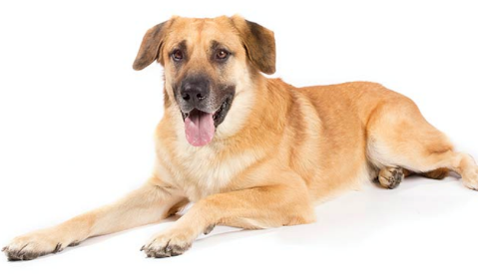

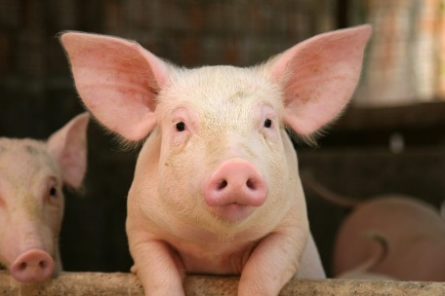
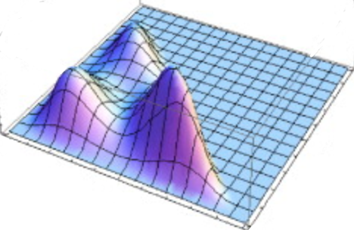

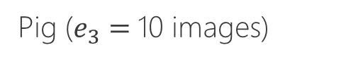
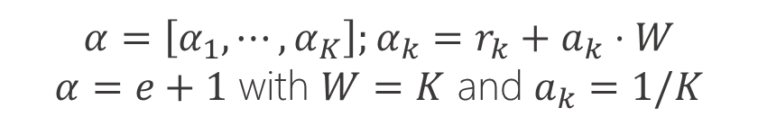
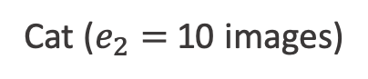

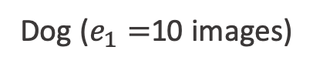
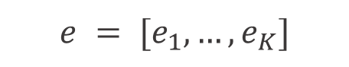
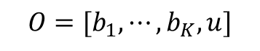
Evidential Uncertainty
Task: 3 class image classification
Training Data:
Dog ($e_{1}=$10 images)
Cat ($e_{2}=$10 images)
Pig ($e_{3}=$10 images)
$$e = [e_{1},…, e_{K}]$$
Evidence
(Historical observations)
$$b_{i}=\frac{e_{i}}{\sum_{k=1}^{K}{α_{k}}}$$
Belief
Opinion
$$O=[b_{1},⋯, b_{K}, u]$$
where $u$ is vacuity and $α$ is the strength of each singleton belief.
$$α=\left[α_{1},⋯, α_{K}\right];α_{k}=r_{k}+a_{k}⋅W$$
$α=e+1$ with $W=K$ and $a_{k}=1/K$
A subjective opinion modeled based on `Subjective Logic’ which uses Dirichlet distribution to measure multiple dimensions of uncertainty in classification tasks

Slide 6


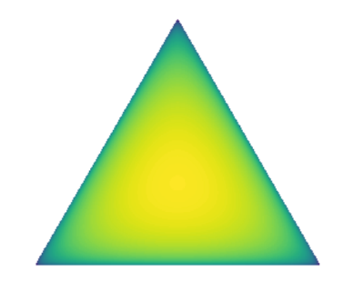
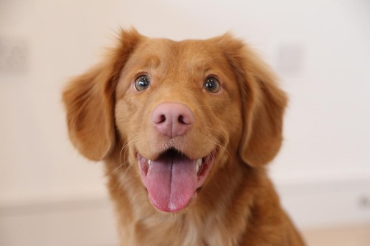
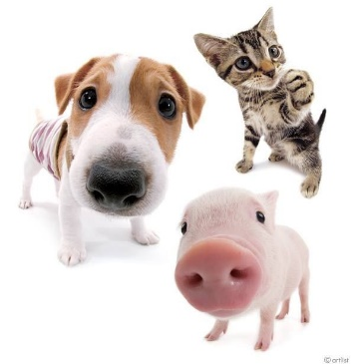
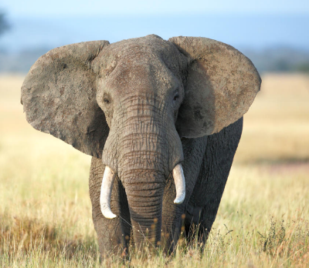
Why Evidential Uncertainty?
Confidence Prediction
Conflict Prediction
Out-of-Distribution
Different Vacuity
Dirichlet Distribution
α = [11, 1, 1]
α = [11, 11, 11]
α = [1, 1, 1]
Expected Probability
p = [0.83, 0.083, 0.083]
p = [1/3, 1/3, 1/3]
p = [1/3, 1/3, 1/3]
High Dissonance
(conflicting evidence)
High Vacuity
(lack of evidence)
Low Uncertainty
Sample
probability
Test image
Notes:
Why evidential uncertainty, rather than probabilistic uncertainty?
Test a dog image: easy, correct classification with low uncertainty (enough amount of evidence; no conflicting evidence)
Test with all dog, cat, and pig together: prediction with 1/3; each category supports with an equal amount of evidence
Test with an elephant (out-of-distribution sample); lack of evidence, high vacuity with Dirichlet distribution being a uniform distribution.
Probabilistic uncertainty cannot distinguish the conflicting case and out-of-distribution case. Basically probabilistic uncertainty is effect when a sufficient amount of evidence with no conflicting evidence is available.

Slide 7
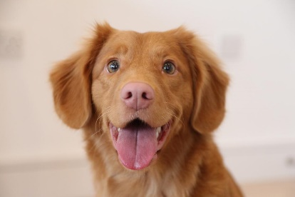
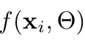
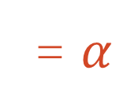
How to train a model estimating the Dirichlet distribution with evidential uncertainty?
Evidential Neural Networks
……
…
Pooling
Convolution
Convolution
Pooling
Dirichlet Distribution
CNN model
= $α$
Higher classification accuracy and
Uncertainty estimation
Square Loss:
Prediction error
Variance
Expected Probability
Minimize
Notes:
How to train a model to estimate the Dirichlet distribution?
Change the layer of the DL model directly to output the alpha (a parameter of Dirichlet distribution), instead of the softmax layer in traditional CNN model (an activation layer (e.g., ReLU) to ascertain non-negative output, which is taken as the evidence vector for the predicted Dirichlet distribution.)
CNNs take a different approach towards regularization: they take advantage of the hierarchical pattern in data and assemble more complex patterns using smaller and simpler patterns. Therefore, on the scale of connectedness and complexity, CNNs are on the lower extreme.
Then we define a square loss that can decompose the expected probability into prediction error and variance and aims to minimize both for higher accuracy in classification and uncertainty estimation.
However, this Evidential Neural Network is not enough because the loss function only care about the expected probability, did not consider the alpha which are considered to estimate multidimensional uncertainty.

Slide 8
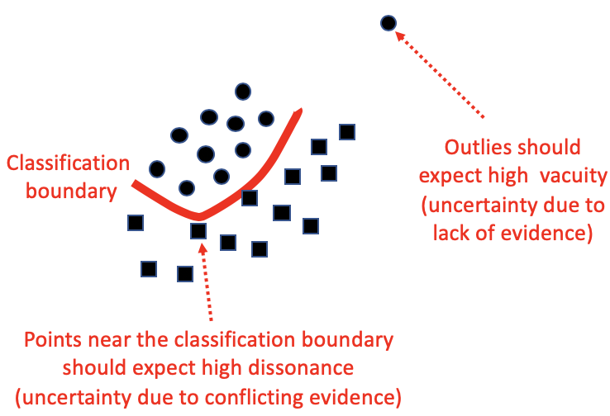
Regularized Evidential Neural Networks for Quantifying Uncertainty
Out-of-Distribution (OOD) samples
Boundary samples
High Vacuity
High Dissonance
Define the outlier samples for testing OOD
Minimize the loss function by maximizing vacuity for OOD and dissonance for boundary samples, in addition to the normal loss function to maximize prediction accuracy.
Notes:
So we proposed Regularized Evidential Neural Networks. First, we define the outlies sample (OOD) is far away from training data, we hope these samples own high vacuity, and boundary sample between two class, these kind of sample should have high Dissonance.
So we add two regularized term in the loss function, trying to maximize the vacuity for OOD and maximize dissonance for boundary sample.

Slide 9
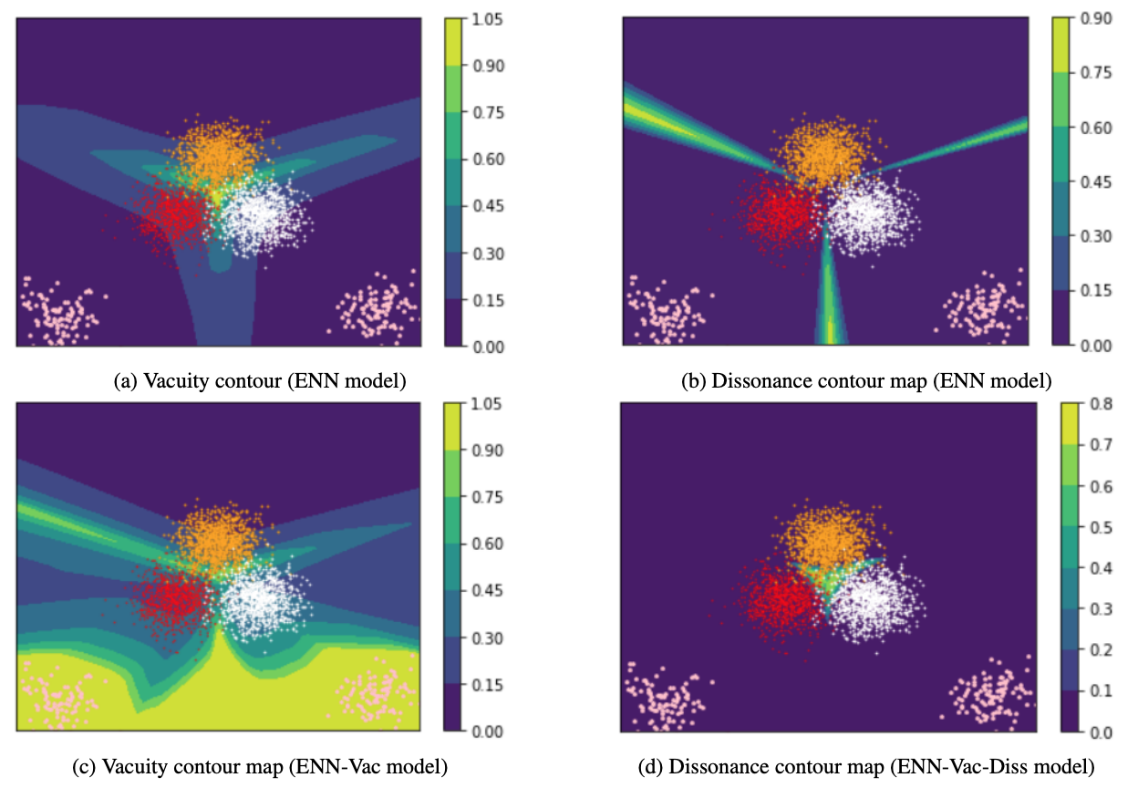
Quantifying vacuity and dissonance under different ENN models
Setting:
Generated a synthetic dataset with three classes: red, orange, and white.
Under a given NN model, we sampled 1000 points of each class based on the Gaussian distribution in a 2-D space.
We used 200 total OOD samples to train regularized- ENN models.
OOD
Results:
Under regularized-ENN models, high vacuity in OOD region and high dissonance on in-class boundary are observed.

Slide 10
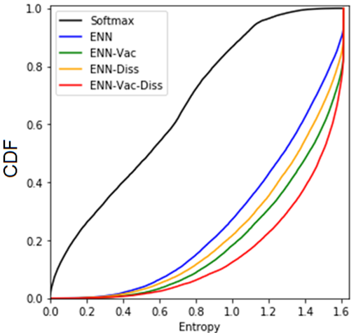
OOD Detection vs. Entropy
Setting:
10 classes of Cifar10 dataset are divided in 3 groups:
{airplane, automobile, bird, cat, deer}: training and validation
{ship, truck}: OOD training
{dog, frog, horse}: OOD detection test
Result:
Right most corner is more desirable in OOD (higher entropy is associated with higher OOD detection)
Higher vacuity (e.g., ENN-Vac with green; ENN-Vac-Diss with red) is obviously related to higher OOD.
The proposed regularized-ENN models show clearer uncertainty effect in OOD detection than the baseline models.

Slide 11
Conclusions
We proposed regularized Evidential Neural Networks (ENN) considering evidential uncertainty, vacuity and dissonance.
We showed anticipated predictive measurements of vacuity and dissonance in our proposed ENN-Vac and ENN in out-of-distribution (OOD) and boundary samples.
We validated the outperformance of our proposed method (i.e., ENN-Vac-Diss) over other schemes in terms of the performance in the OOD detection task.
We bridged a belief/evidence model with deep learning to predict multidimensional uncertainty.

Slide 12
Open Research Questions
Why is predicting uncertainty important?
What is knowing an extent of uncertainty useful for decision making?
What types of uncertainty are more important than others?
Is lack of information better than wrong information?
Is perceiving high uncertainty better than misclassification?

Slide 13

Thank you!
Any Question & Comments?
Jin-Hee Cho, CS@VT
jicho@vt.edu

